Slide 1

Sprint #3: Team KickOff
Project Manager:
Nicholas Jones
Scrum Master:
Jeff Bruggeman
Programmer 1:
Pranta Dey
Programmer 2:
Van Do
Tester:
Julian Sosa

Slide 2

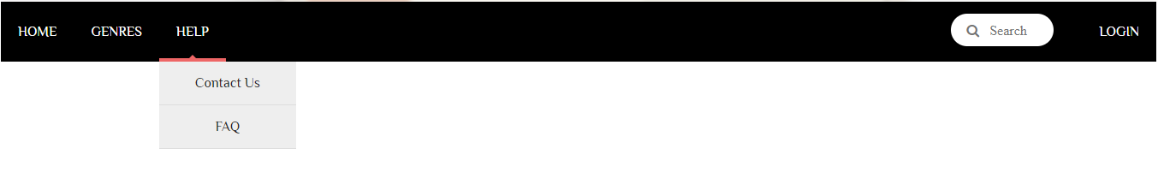
OVERVIEW
I Book U is an online bookseller and retailer of content, digital media, and educational products.
Our website would sell books, magazines, newspapers, etc. to audiences across the United States.
During the last sprint, we were able to implement our foundation of our site by creating our home page and use the navigation bar to maneuver to the rest of the site.
Initial Logo

Slide 3
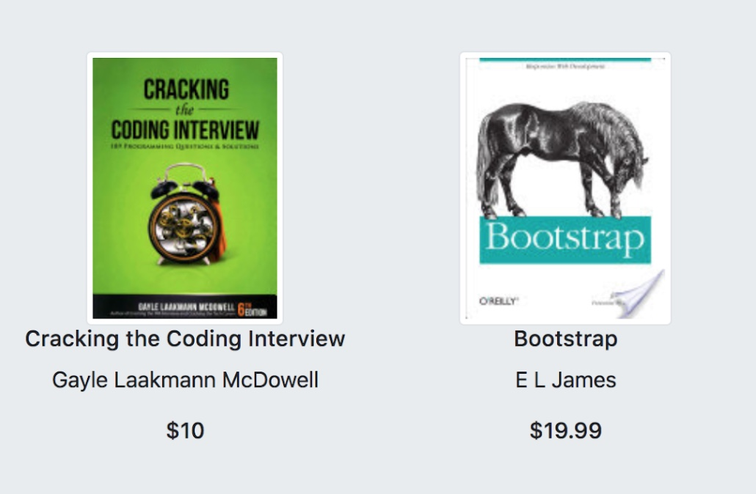
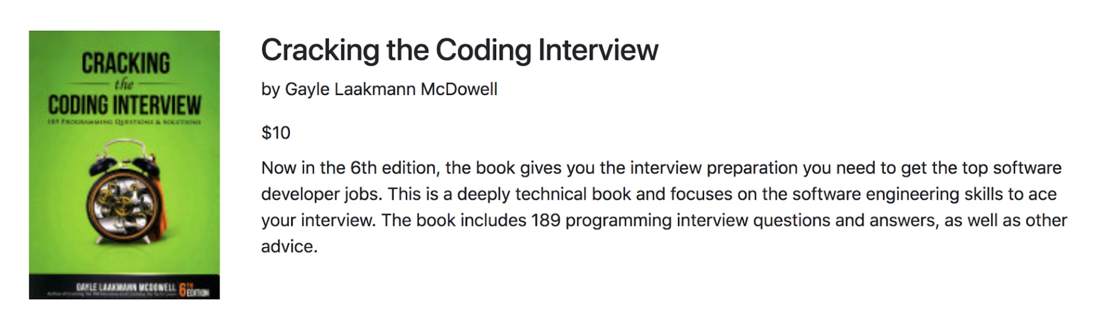
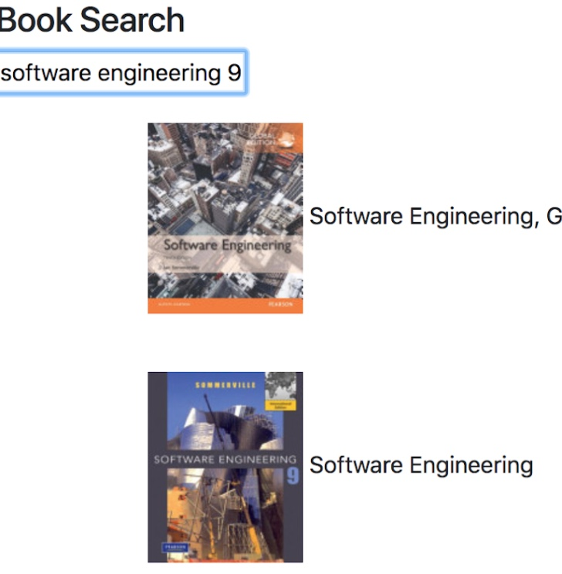
SPRINT 3
Currently, we have added our products to our website and users able to locate books and are given brief details about their selection
On the admin side, we are able to perform full-text searches and retrieve book information by using Google Books API.

Slide 4
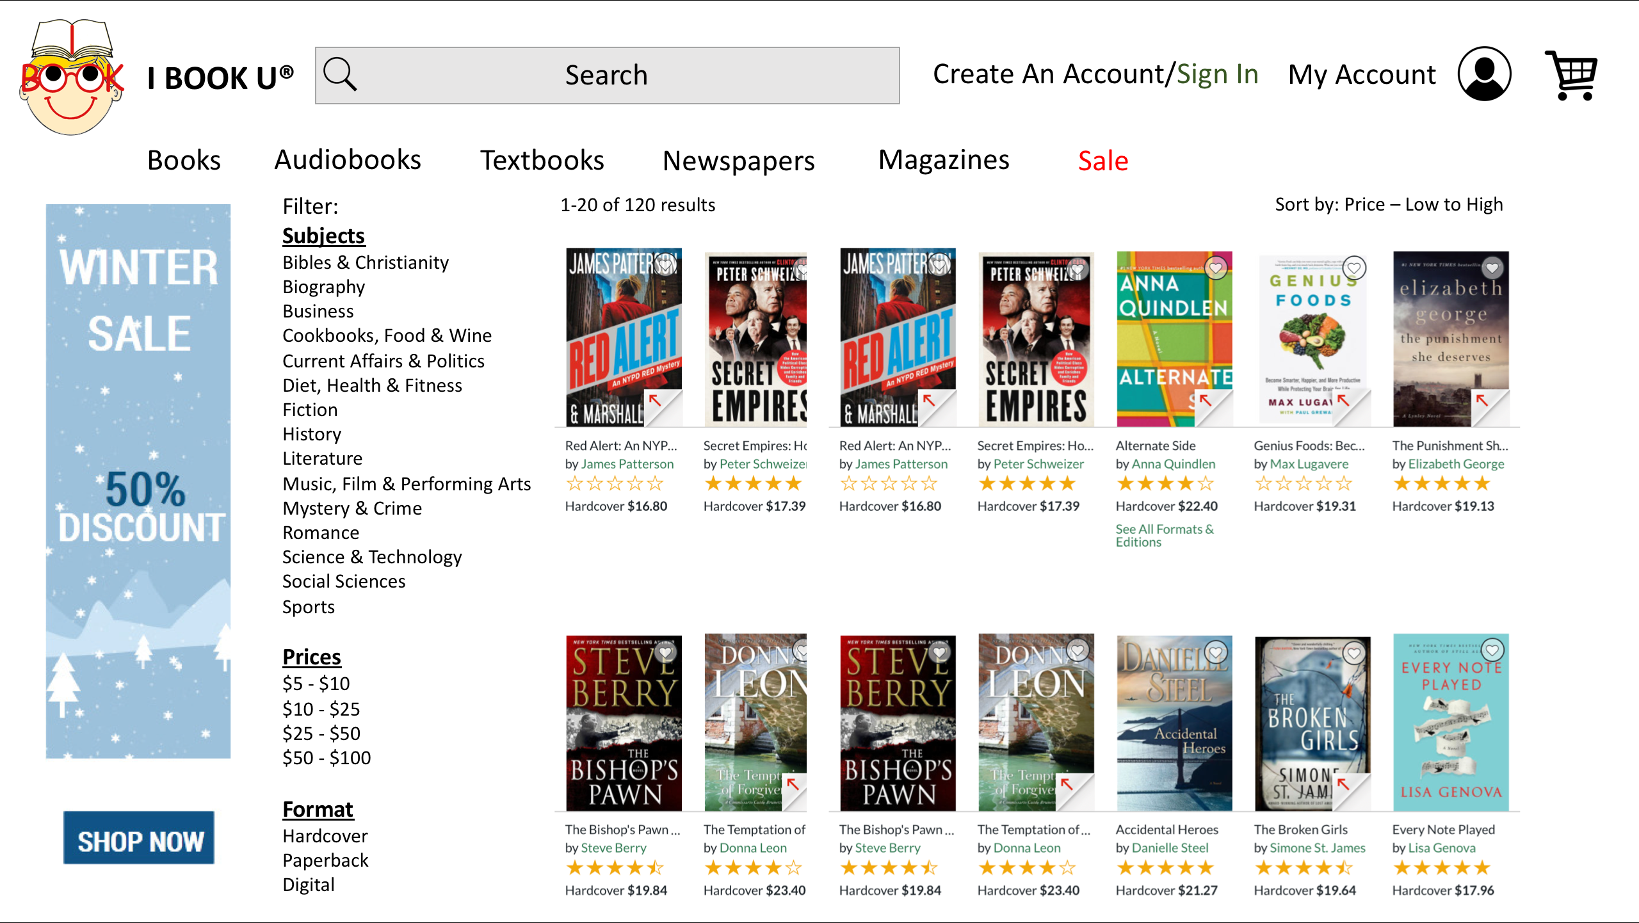
MOCK UP

Slide 5
SYSTEM CONTEXT DIAGRAM
User
iBOOKu
Shopping
System
User information
Inventory Management
Admin
Order Details
Admin Inventory Management
Book Details
Search Results
Contact Us

Slide 6
OBJECT CLASS diagram
Spring Boot
Declare(/books) User(attributes) Book(attributes) Cart(attributes) Order(attributes) Wishlist(attributes) getters() setters()
Angular
NavBar
getBook(string)
BookDetails
addCart(book.id) deleteCart(book.id) addWish(book.id) deleteWish(book.id)
book.title book.price book.author book.id
Cart
clearCart() finalizeCart() deleteCart(book.id)
Admin
addBook(Book) deleteBook(Book)
Book(attributes)
Login
userAdd(User) userConfirm()
User(attributes)
MySQL
Book Table User Table Cart Table Order Table Wishlist Table

Slide 7
TEST SCENARIOS
Scenario #1 | Scenario #2 | Scenario #3
Account Creation Page | Admin Page | NavBar
User must enter string lengths that conform to both the Spring Boot Class constraints and MySQL attribute constraints User cannot associate more than one account with a single email or username Ensure that once account is created, the account is successfully created in MySQL Ensure all these in Firefox, Chrome, Safari and IE | Check that API returns enough info to ensure correct book can be selected If certain info is not returned, ensure that upon addition that there is a text error message informing admin of missing information Ensure that the information is added correctly to MySQL table Manually check Google API vs random searches using the admin search bar to ensure reliable use Ensure all these in Firefox, Chrome, Safari and IE | Ensure correct pages are navigated to using the buttons available Ensure that the genre tabs return the correct genre of books Ensure that the search bar returns correct list of books based on search term Ensure the alignment and order of buttons conforms to current version specs on Firefox, Chrome, Safari and IE

Slide 8
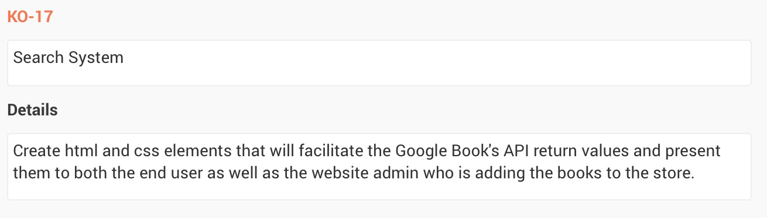
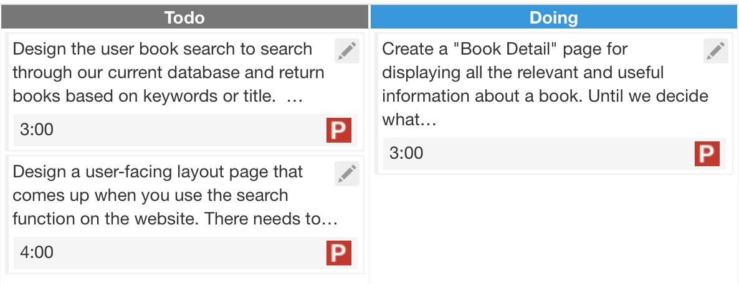
First story

Slide 9
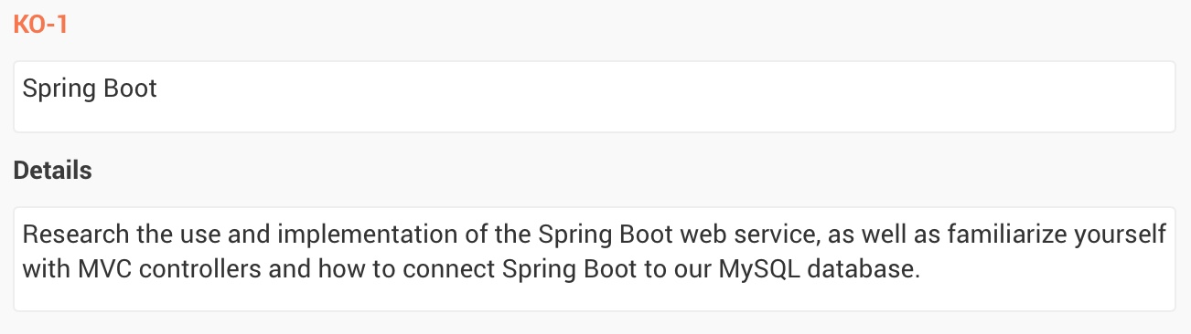
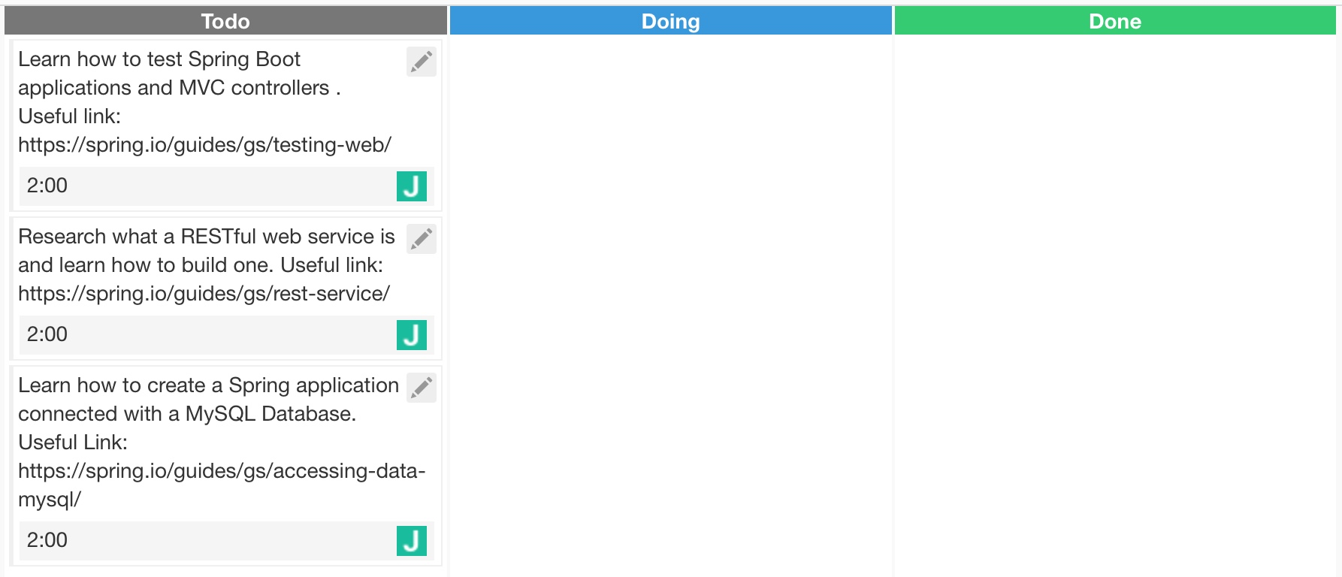
second story

Slide 10
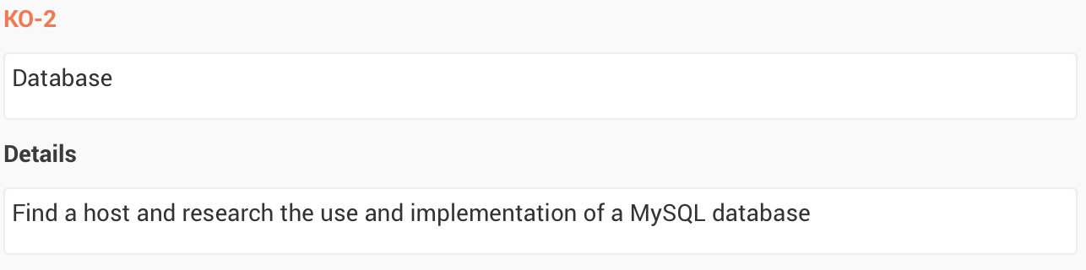
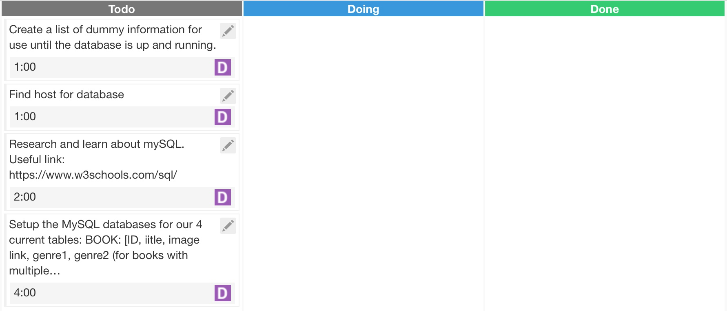
third story

Slide 11
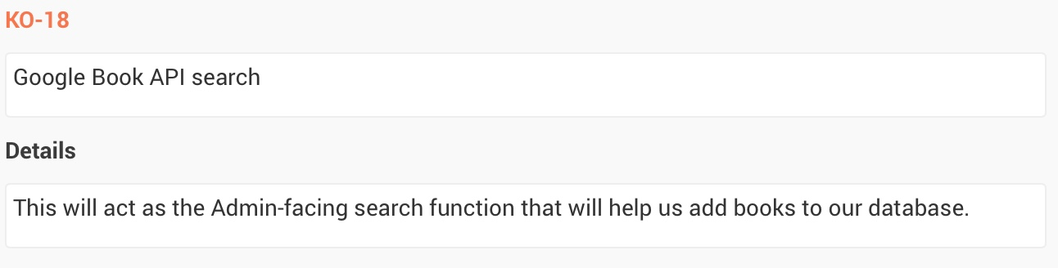
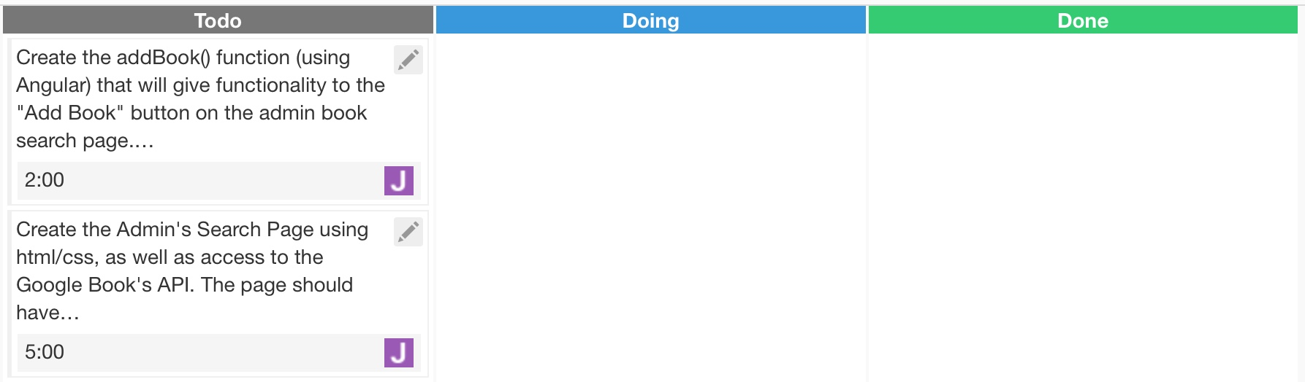
Fourth story

Slide 12
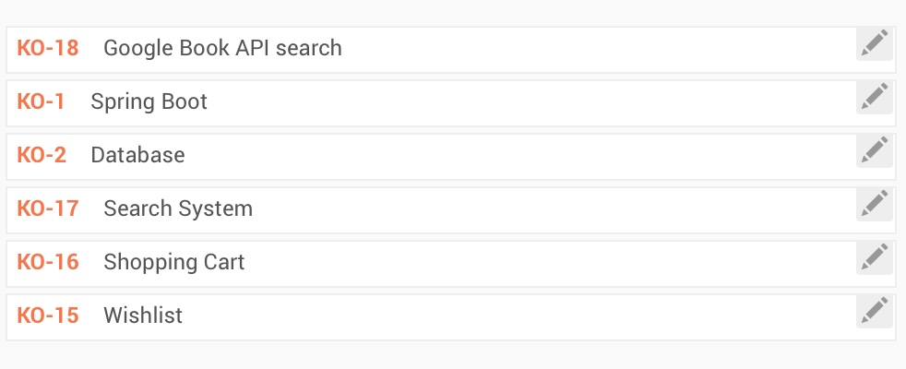
Backlog

Slide 13
Show Burn-down chart
Velocity
Sprint 2: 2 hr/day
Sprint 3: .43 hr/day

Slide 14
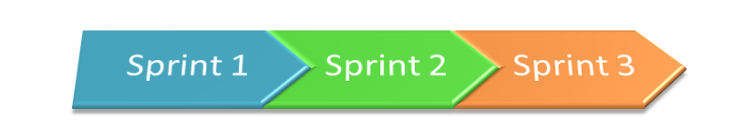
Next Sprint
For the following sprint we plan on:
Writing RESTful web services
Working with databases
Including Angular services that help transfer data

